Slide 1
Frontend Oriented Framework & Infra…
An UI Landscape that scales

Slide 2
overview
Know about a web-portal
architecture
Micro-layered , captive , testable code
Aggregated deployable piece
proof of concept
Setup corporate repository
Setup base components
Modern techniques of building the portal
Enterprise strategies
Zero downtime, scalable
write business logic to create your own app

Slide 3

Web-portal
Js bundle
js
html
css
Image/fonts
Data
Runtime

Slide 4
Web-portal
js-minified
Css-minified
Image/fonts (Sprites)
Data
Runtime

Slide 5
Infra
grunt
bower
develop
angular
angular-ui
certify
karma
Jasmin
Local bower repo
sass/less
cdn compatible
bootstrap
Rwd templates
Protector
jenkin

Slide 6
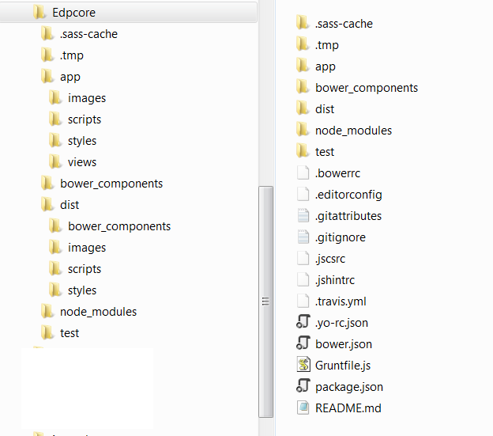
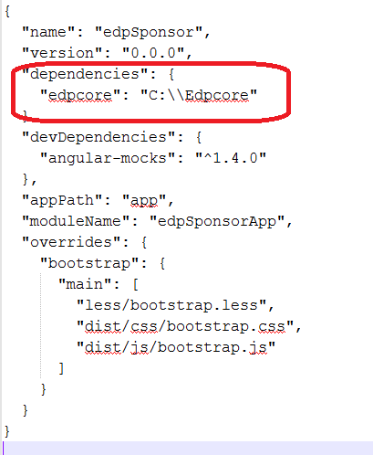
Repo layout

Slide 7
Public repository
Angular-resource
Angular-ui-router
angular-sanitize
Angular-mocki
angular-bootstrap
angular-cookies
Angular-ui
bootstrap-sass
derived
edp-web-sandbox
edp-sponsor
Local repository
Local repository
edp-common-login
edp-sponsor-prm
derived
edp-common-logging
edp-sponsor-proposal
edp-common-userprofile

